Slide 1

IOINC NATIVE - Notes

Slide 2
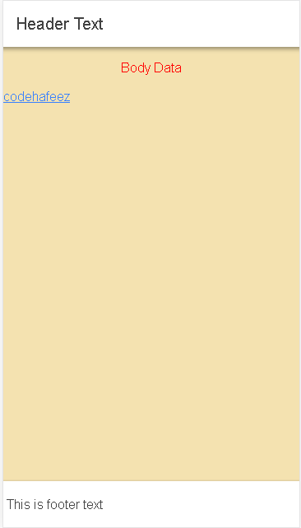
<ion-header>
<ion-toolbar><ion-title>Header Text </ion-title></ion-toolbar>
</ion-header>
<ion-content>
<p class="data">Body Data</p>
<a target="_blank" href="https://codehafeez.blogspot.com/">codehafeez</a>
</ion-content>
<ion-footer>
<ion-toolbar>This is footer text</ion-toolbar>
</ion-footer>
home.page.html
Create & Work with Components
Header
Footer
Body
Design CSS
ion-content {
--ion-background-color: #f4e2b0;
}
.data {
color:red;
text-align:center;
}
home.page.scss

Slide 3
cmd run in project --- create new page
ionic generate page page01
// if you wan’t to remove the page than remove folder as well as remove form there also.
import { NgModule } from '@angular/core';
import { Routes, RouterModule } from '@angular/router';
const routes: Routes = [
{ path: '', redirectTo: 'page01', pathMatch: 'full' },
{ path: 'home', loadChildren: './home/home.module#HomePageModule' },
{ path: 'page01', loadChildren: './page01/page01.module#Page01PageModule' },
];
@NgModule({
imports: [RouterModule.forRoot(routes)],
exports: [RouterModule]
})
export class AppRoutingModule { }
Create Page, Remove, and Set Default Page
app-routing.module.ts

